Slide 1

Analysis of fatigue detection algorithms and user focus, using computer vision tools
Stanislav Skytsiuk
National Technical University of Ukraine
“Igor Sikorsky Kyiv Polytechnic Institute”
Institute of Applied Systems Analysis
Notes:
Нужно название переформулировать, чтобы оно более точно отражало, то что сделано.

Slide 2

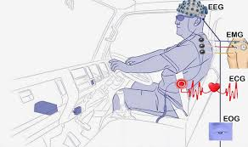

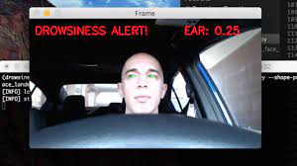
What is fatigue?
Motivation
Fatigue is extreme tiredness resulting from mental or physical exertion or illness.
Fatigue can be caused by a number of factors working in combination, such as medical conditions, unhealthy lifestyle choices, workplace problems and stress.
Symptoms: lack of energy, constant tiredness or exhaustion; lack of motivation; difficulty with concentration, starting and completing tasks
Methods for fatigue detection
Psychology-based approach that generally relies on psychometric questionnaires to evaluate an individual's fatigue level
Physiological approach that makes use of bio-signals (EEG, ECG etc.) associated with fatigue
Video-based approach that usually monitors the behavioral and physical status of the driver, such as facial features, head position, reaction time, steering errors, lane deviation, etc.
requires the direct participation of the user
requires wearing uncomfortable equipment
no distraction, no inconvenience
Notes:
Можно добавить, что 1й метод опирается на субъективную оценку своего состояния пользователем, а 2й и 3й более объективны.

Slide 3
General Workflow
Similar applications
Eye strain and fatigue, that result from prolonged computer use
Drivers fatigue
Rare publications, no commercial applications are available
Well studied, commercial applications are available
Some techniques can also be applied to long-time computer workers
General workflow:
Human fatigue expression recognition
Input video from camera
Output decision
Face detection
Notes:
Какого то такого типа слайд здесь нужен, а потом начиная со следующего уже конкретно по статьям

Slide 4
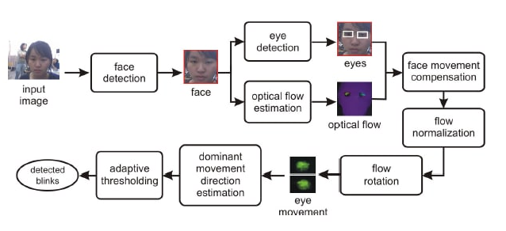
M.Divjak, H.Bischof, Eye blink based fatigue detection for prevention of Computer Vision Syndrome,
Proceedings of IAPR Conf. on Machine Vision Applications (MVA), 2009*
Approach main steps:
Input video from monitor-mounted camera
Each frame processed by 3 different classifier to detect locations of user’s face, left and right eye (open CV version of Adaboost)
Fig.1 Eye blink detection process
Optical flow algorithm is used to detect closing and opening for each eye and in each video frame separately
This blinking information is used to calculate three metrics (see Fig. 2) that describe changes in blink behaviour.
Fig.2 : Illustration of differences between normal eye behaviour (solid line)) and fatigue (dashed line) in a typical test video.
*https://www.tugraz.at/fileadmin/user_upload/Institute/ICG/Images/team_bischof/mib/paper_pdfs/2009DivjakMVA.pdf
Notes:
Например так можно одним слайдом описать подход

Slide 5
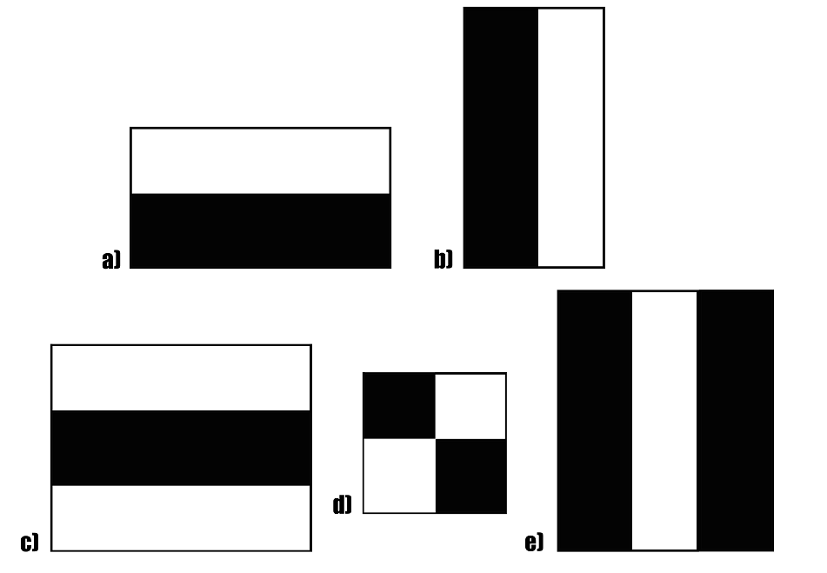

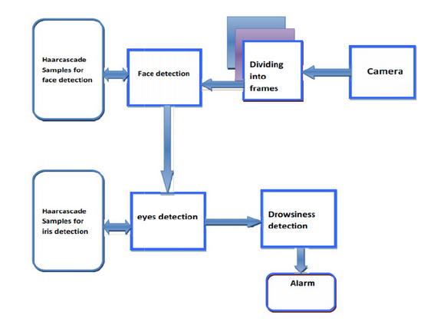
Automatic Driver Drowsiness Detection Using Haar Algorithm and Support Vector Machine Techniques
Asian Journal of Applied Sciences, 8: 149-157,2015
Haar cascades
It is an Object Detection Algorithm used to identify faces in an image or a real time video. The algorithm uses edge or line detection features .
Fig.1 Haar primitives
The objective here is to find out the sum of all the image pixels lying in the darker area of the haar feature and the sum of all the image pixels lying in the lighter area of the haar feature. And then find out their difference.
Fig.2 Example of working algorithm
In essence, the Haar-like feature value reflects the greyscale change of the image, for example: the eyes are darker than the cheeks, and the mouth is darker than the surrounding colors.
*https://www.researchgate.net/publication/271376030_Real_Time_Drowsy_Driver_Detection_Using_Haarcascade_Samples
Fig.3 Haar based system

Slide 6
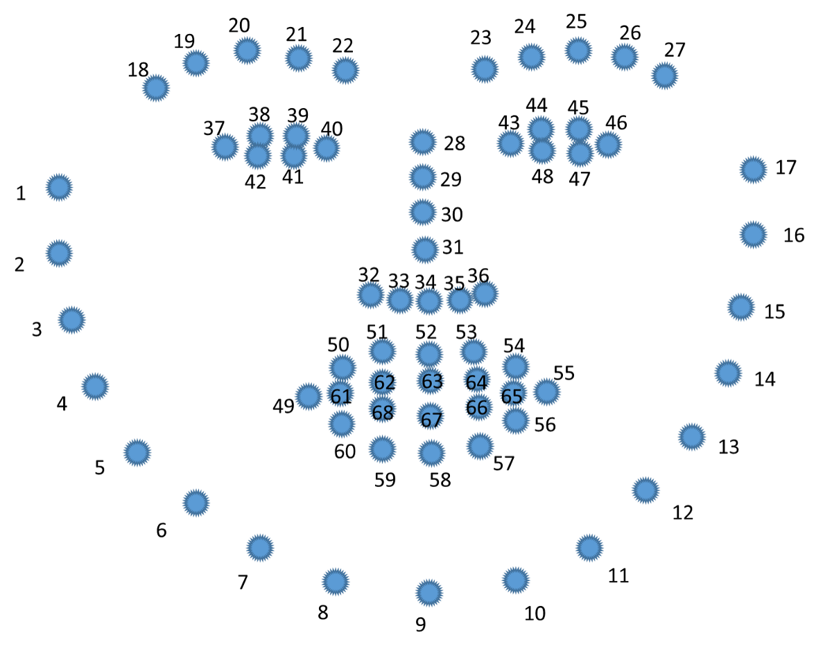
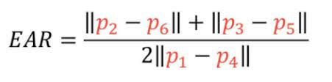

Tianjun Zhu, Research on a Real-Time Driver Fatigue Detection Algorithm Based on Facial Video Sequences
Department of Mechanical and Automotive Engineering, Zhaoqing University, Zhaoqing, 2022*
The aspect ratio of the eyes (EAR) can reliably estimate the degree of driver's eye opening, and plays a vital role in fatigue detection
ear < 0.20 - person is drowsy
A common and effective method for the face is the PERCLOS , which refers to the percentage of eye closure time in a certain period of time. The fatigue state depends on the closed state of the eyelids.
Fig.1. Eye blink detection process
First, we locate the eye contour according to the 68- Landmark model.
perclos > 0.22 - person is drowsy
* https://www.mdpi.com/2076-3417/12/4/2224/pdf?version=1645437674

Slide 7
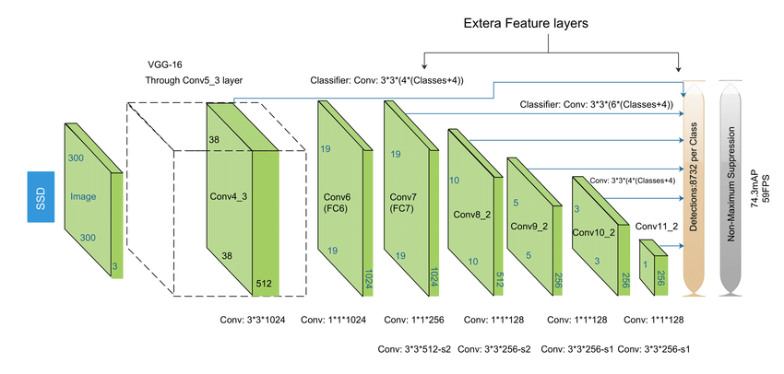
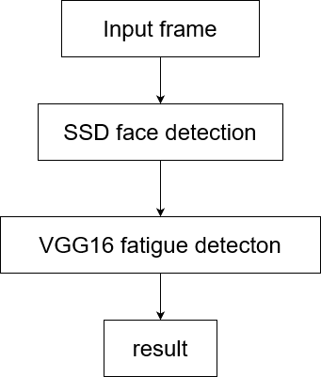

Guangzhe Zhao, Research on fatigue detection based on visual features
The Institution of Engineering and Technology, 2020*
Detection method based on deep learning
The method mainly includes two steps: first is the face detection algorithm, and second is the fatigue detection network model
Fig.1 Single Shot MultiBox Detector
Prototype:
Fig.2 Visual Geometry Group 16
*https://ietresearch.onlinelibrary.wiley.com/doi/pdfdirect/10.1049/ipr2.12207

Slide 8
State-of-art methods
Research​ | Year​ | Method ​ | Accuracy (%)​
AL-Anizy[1] | 2015 | Haar cascades | 90.5*
Shih[2] | 2016​ | MSTN​ | 82.61​
Jabbar ​[3] | 2018​ | MLP​ | 80.92​
Xing ​[4] | 2019​ | CNN+PERCLOS​ | 87.5​
Li ​[5] | 2019​ | Multi-feature fusion​ | 86.25​
Jabbar ​[6] | 2020​ | D2CNN-FLD​ | 83.3​
Jabbar ​[6] | 2020​ | AlexNet​ | 82.8​
Jabbar ​[6] | 2020​ | Faster RCNN​ | 90.5​
Zhao​[7] | 2021​ | SSD+VGG16​ | 91.88​
Testing Data Set - NTHU-DDD data set
https://ietresearch.onlinelibrary.wiley.com/doi/pdf/10.1049/ipr2.12207

Slide 9

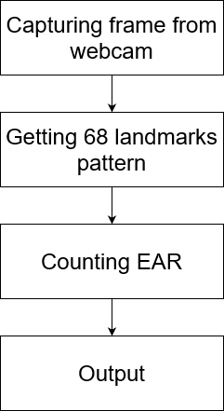
Demo
For this prototype was used Python programming language with the help of Dlib and OpenCV libraries, which are free-to-use opensource libraries for machine learning and computer vision.
Green – normal EAR
Red – low EAR
Fig. 1. Eye blink detection process

Slide 10
References
Papers
1.Ghassan Jasim AL-Anizy, Md. Jan Nordin and Mohammed M. Razooq, 2015. Automatic Driver Drowsiness Detection Using Haar Algorithm and Support Vector Machine Techniques. Asian Journal of Applied Sciences, 8: 149-157.
2. Weng, C.H., Lai, Y.H., Lai, S.H.: Driver drowsiness detection via a hierar-chical temporal deep belief network. In: Asian Conference on ComputerVision, pp. 117–133.Springer (2016)
3. Jabbar, R., et al.: Real-time driver drowsiness detection for android appli-cation using deep neural networks techniques. Procedia Comput. Sci. 130,400–407 (2018)
4. Jabbar, R., et al.: Driver drowsiness detection model using convolutionalneural networks techniques for android application. In: IEEE Inter-national Conference on Informatics, IoT, and Enabling Technologies (ICIoT), pp. 237–242.IEEE (2020)
5. Shih, T.H., Hsu, C.T.: MSTN: Multistage spatial-temporal network for driver drowsiness detection. In: Asian Conference on Computer Vision, pp. 146–153. Springer (2016)
6. Xing, J., et al.: Application of face recognition based on CNN in fatigue driving detection. In: Proceedings of the International Conference on Arti-ficial Intelligence and Advanced Manufacturing, pp. 1–5 (2019)
7. .Li, X., et al.: Fatigue driving detection model based on multi-feature fusion and semi-supervised active learning. IET Intel. Transport Syst. 13(9), 1401–1409 (2019)
8. M.Divjak, H.Bischof, Eye blink based fatigue detection for prevention of Computer Vision Syndrome, Proceedings of IAPR Conf. on Machine Vision Applications (MVA), 2009
9. Real time drowsy driver detection using Haarcascade samples, PES Institute of Technology-South Campus, Bangalore, India, 2022
10. Tianjun Zhu, Research on a Real-Time Driver Fatigue Detection Algorithm Based on Facial Video Sequences, Department of Mechanical and Automotive Engineering, Zhaoqing University, Zaoqing, 2022
11. Zhao, G., He, Y., Yang, H., Tao, Y.: Research on fatigue detection based on visual features. IET Image Process. 16, 1044–1053 (2022).
12.Ghassan Jasim AL-Anizy, Md. Jan Nordin and Mohammed M. Razooq, 2015. Automatic Driver Drowsiness Detection Using Haar Algorithm and Support Vector Machine Techniques. Asian Journal of Applied Sciences, 8: 149-157.
Blogs
https://nvjournal.ru/article/33-ustrojstvo-slezheniya-za-sostoyaniem-voditelya-/
http://ijet.pl/old_archives/2010/4/62.pdf
https://ietresearch.onlinelibrary.wiley.com/doi/pdfdirect/10.1049/ipr2.12207
https://github.com/jaisayush/Fatigue-Detection-System-Based-On-Behavioural-Characteristics-Of-Driver
https://www.mdpi.com/2076-3417/11/19/9195/htm

Slide 11
Thank you for attention!

